Slide 1


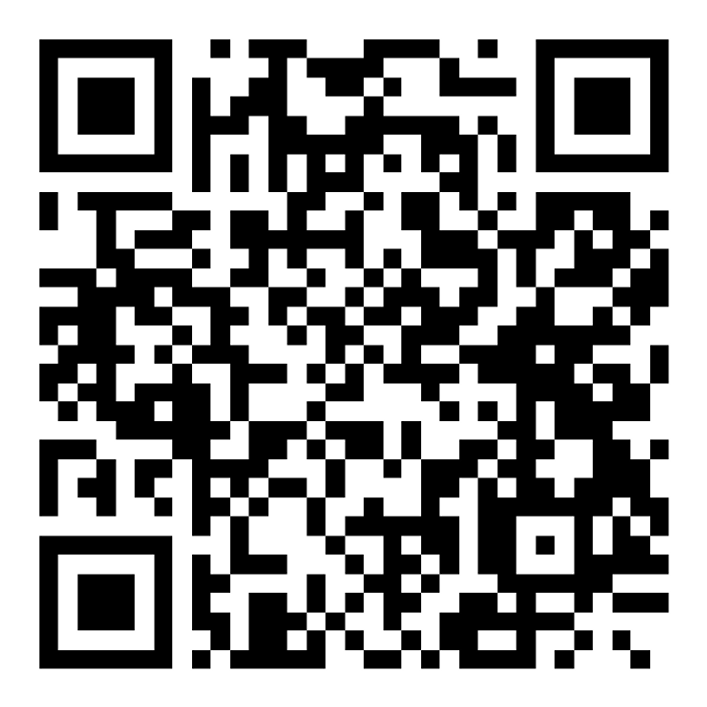

The cancer-immunity cycle
November 2–4, 2025 – Sitges, Spain
Keynote speakers:
Ira Mellman, USA
Carl June, USA
Abstract submission deadline:
July 25, 2025
Speakers
Sebastian Amigorena, France
George Coukos, Switzerland
Catherine Fridman, France
Jon Kagan, USA
Marleen Kok, Netherlands
Laura Mackay, Australia
Erika Pearce, USA
Filipe Pereira, Sweden
Mikael Pittet, Switzerland
Yardena Samuels, Israel
Andrea Schietinger, USA
Josep Tabernero, Spain
Shannon Turley, USA
Karin de Visser, Netherlands
Kai Wucherpfennig, USA
Zemin Zhang, China
Organizers:
Ignacio Melero, Universidad de Navarra, Spain
Ira Mellman, Genentech, South San Francisco, USA
Fabiola Rivas, Deputy editor, Immunity
Montse Rojo de la Vega, Deputy editor, Cancer Cell
Early registration deadline:
September 19, 2025
cell-symposia.com/cancer-immunity-2025

